Slide 1
Auto ml

Slide 2
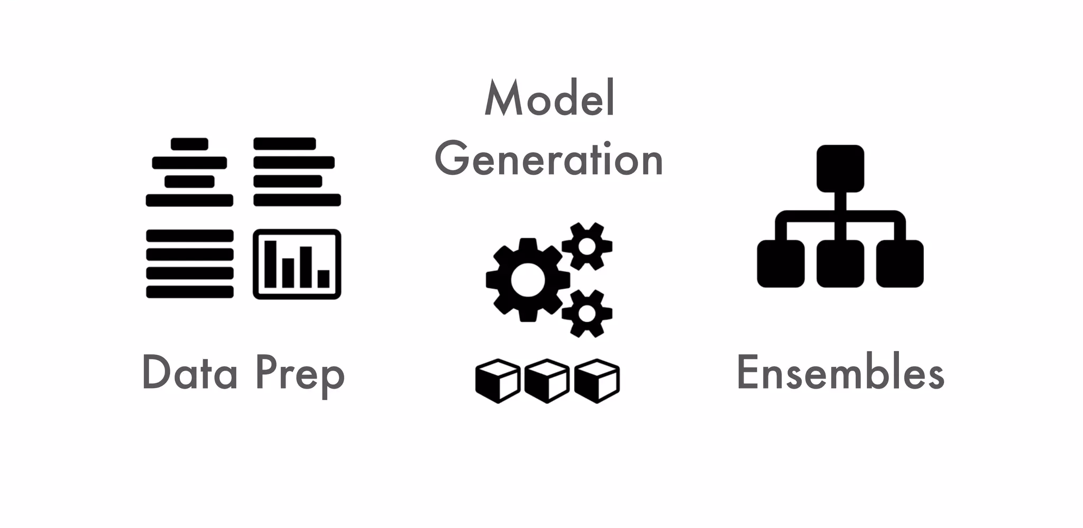
Aspects of AutoML

Slide 3
Aspects of AutoML
Data preprocessing | Imputation, one-hot encoding, standardization Feature selection and/or feature extraction Count/Label/Target encoding of categorical features
Model Generation | Cartesian grid search or random grid search Bayesian Hyperparameter Optimization Individual models can be tuned using a validation set
Ensembles | Ensembles often outperforms individual models Stacking / Super Learning (Wolpert, Breiman) Ensemble Selection

Slide 4
Auto ML - Why
Making it more accessible to a broader range of users, including those without deep expertise in data science or machine learning.
Enabling rapid prototyping and experimentation.
Explores wide range of algorithms and hyperparameter combinations to find the best-performing model, hence has improved model performance.

Slide 5
AutoML tools explored
Auto sklearn
H2O
Azure

Slide 6
Dataset used to evaluate AutoML tools
Title : Credit card customers churn
Predict if customer is going to churn or not (Binary classification)
20 features - age, gender, dependent count, marital status, income category etc.
Highly imbalanced data – existing customers 84% and churned customers 16%
https://www.kaggle.com/datasets/sakshigoyal7/credit-card-customers/data

Slide 7
Auto sklearn
Uses algorithms from scikit learn for pipeline construction
Meta-learning to warm start the instantiations of the ML framework that are likely to perform quite well
Bayesian optimization to find optimal solution
Automatic ensemble construction using ensemble selection
Quick code walk through

Slide 8
Aspects of Auto sklearn
Data preprocessing | Imputation, one-hot encoding, standardization Feature selection and/or feature extraction Count/Label/Target encoding of categorical features
Model Generation | Cartesian grid search or random grid search Bayesian Hyperparameter Optimization Individual models can be tuned using a validation set
Ensembles | Ensembles often outperforms individual models Stacking / Super Learning (Wolpert, Breiman) Ensemble Selection

Slide 9
Algorithms explored by Auto sklearn
Pre-processing steps
Data scaling and transformation
Missing data handling
Categorical data handling
Feature selection
Dimensionality Reduction
Machine learning models explored
Linear models
Tree-based models
SVM
KNN
Naïve bayes
NN

Slide 10
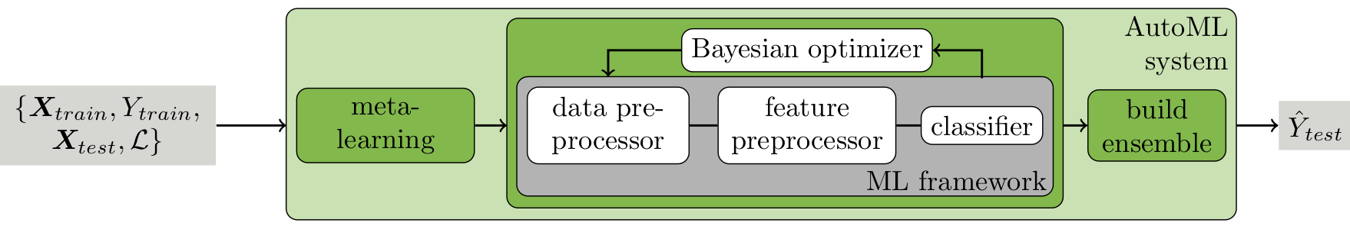
Auto sklearn architecture

Slide 11
Meta learning
For 140 datasets from the OpenML repository, a set of meta-features are evaluated for each
Bayesian optimization was used to determine and store an instantiation of the given ML framework with strong empirical performance for each dataset
Given a new dataset D, meta-features are computed, rank all datasets by their distance to D in meta-feature space and select the stored ML framework instantiations for the k = 25 nearest datasets for evaluation before starting Bayesian optimization with their results

Slide 12
Bayesian Optimization
Bayesian optimization is a probabilistic model-based optimization technique that is used to find the best set of hyperparameters for machine learning models.
It’s an iterative process of – exploring the hyperparameters, evaluating the model performance and updating the probabilistic model.
Surrogate function is a probabilistic model that estimates the relationship between hyperparameters and performance
Acquisition function is a decision-making tool that suggests the next set of hyperparameters to evaluate based on the surrogate function's predictions

Slide 13
Ensemble selection
Ensemble is a greedy procedure that starts from an empty ensemble
Then iteratively adds the model that maximizes ensemble validation performance
To figure out which model to add, each time, separately average the predictions of each model from the library currently being considered with the current ensemble. Then choose the model that provided the most performance improvement.
It adds models with replacement

Slide 14





H2o Machine Learning
Open source, distributed(multicore + multi-node) implementations of cutting edge auto ML algorithms.
It is mainly created for large datasets.
Core algorithms are written in high performance Java.
APIs available in R, Python, Scala; web GUI.
Easily deploy model to production as pure Java code.
Works on Hadoop, Spark, AWS, etc.

Slide 15
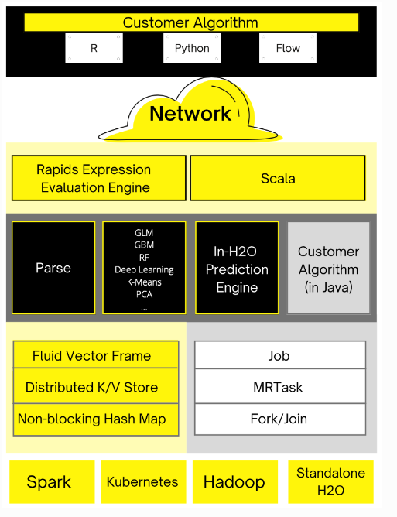
H2O Architecture
The top section shows some of the different REST API clients that exist for H2O.
The bottom section shows different components that run within an H2O JVM process.

Slide 16
Algorithms Explored By H2o
H2O AutoML includes:
XGBoost Gradient Boosting Machines (GBM)
H2O Gradient Boosting Machines (GBM)
Random Forests10 (Default and Extremely Randomized Tree variety)
Deep Neural Networks11 and Generalized Linear Models (GLM)12.

Slide 17
Aspects of H2O AutoML
Data preprocessing | Imputation, one-hot encoding, standardization Feature selection and/or feature extraction Count/Label/Target encoding of categorical features
Model Generation | Cartesian grid search or random grid search Bayesian Hyperparameter Optimization Individual models can be tuned using a validation set
Ensembles | Ensembles often outperforms individual models Stacking / Super Learning (Wolpert, Breiman) Ensemble Selection (Caruana)

Slide 18
Model Generation
Grid Search:
It sets up a grid of possible hyperparameter values.
Creates model with all possible combinations.
Trains & validates all the models.
Returns the best model.
Also returns the most suited hyper-parameters
We can further narrow down & repeat.

Slide 19
Model Generation
Random Search:
Set up a grid of possible hyperparameter values.
select random combinations to train the model and score.
The number of search iterations is set based on time/resources.

Slide 20
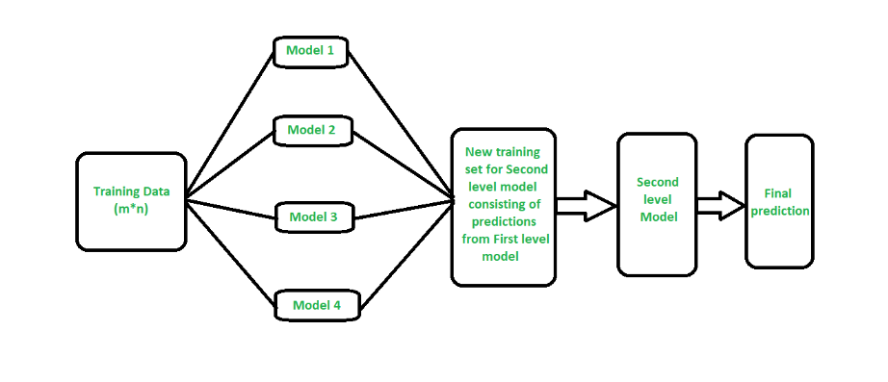
Ensemble Construction Using Stacking

Slide 21
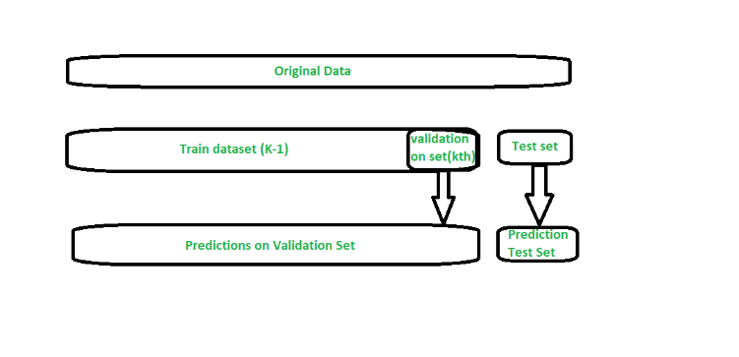
Problem in Stacking
If we just use training and test split data to evaluate all the models, then it can lead to overfitting.
If one or more base models are overfitting, then the second-level model(Meta-learner) will predict that model to be the perfect model and will assign more weight to it.
Hence, the Meta Learner will get affected by overfitting.
To reduce overfitting, we can use K fold Cross Validation.

Slide 22
H2O Workflow
Basic data pre-processing.
Trains random grid of GBMs, DNNs, GLMs, etc. using a carefully chosen hyper-parameter space.
Individual models are tuned using validation set.
Two stacked Ensembles are trained(“All models ensemble & a lightweight “Best of Family ensemble).
Returns a sorted leaderboard of all models.
Best model is choosed and the precition of training set is done.

Slide 23
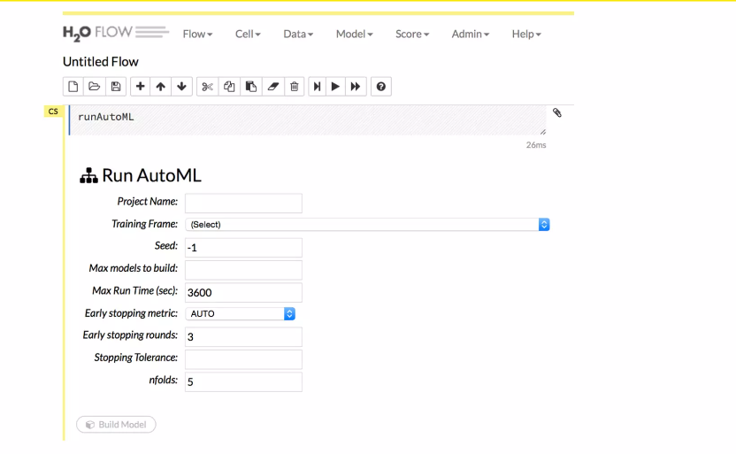
H2O AutoML in GUI

Slide 24
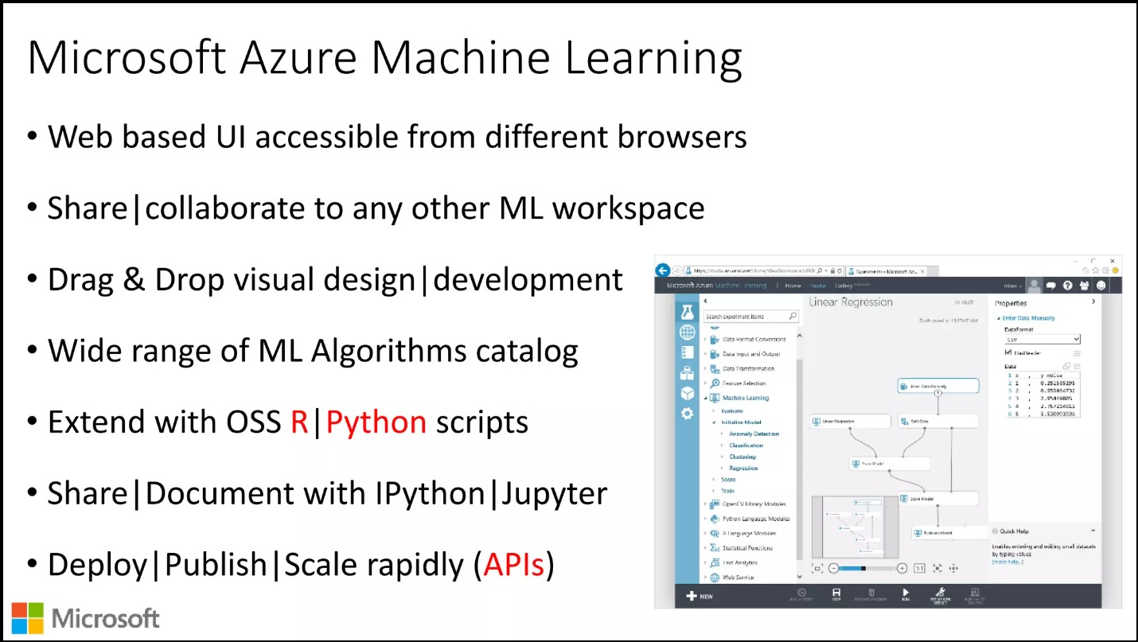

Slide 25
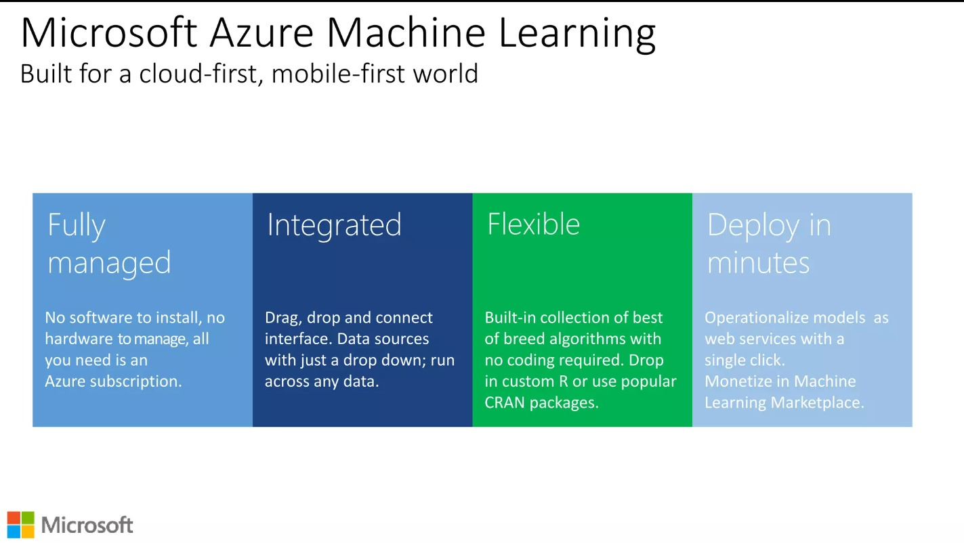

Slide 26
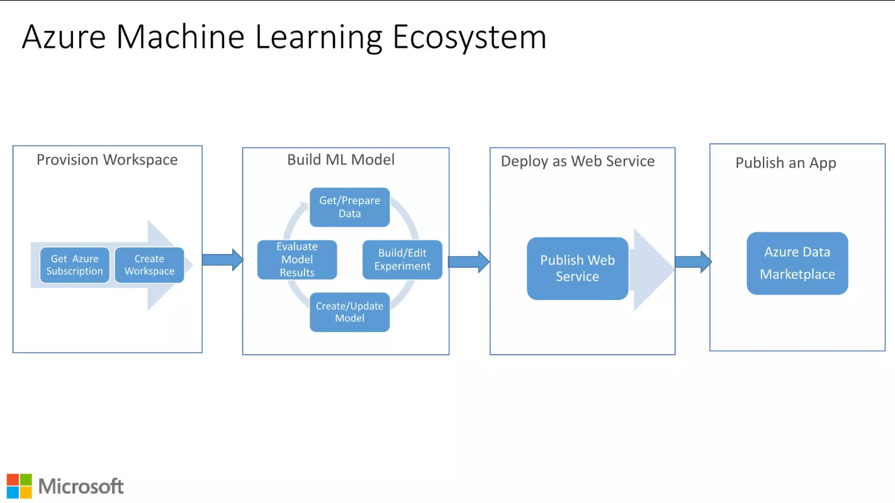

Slide 27
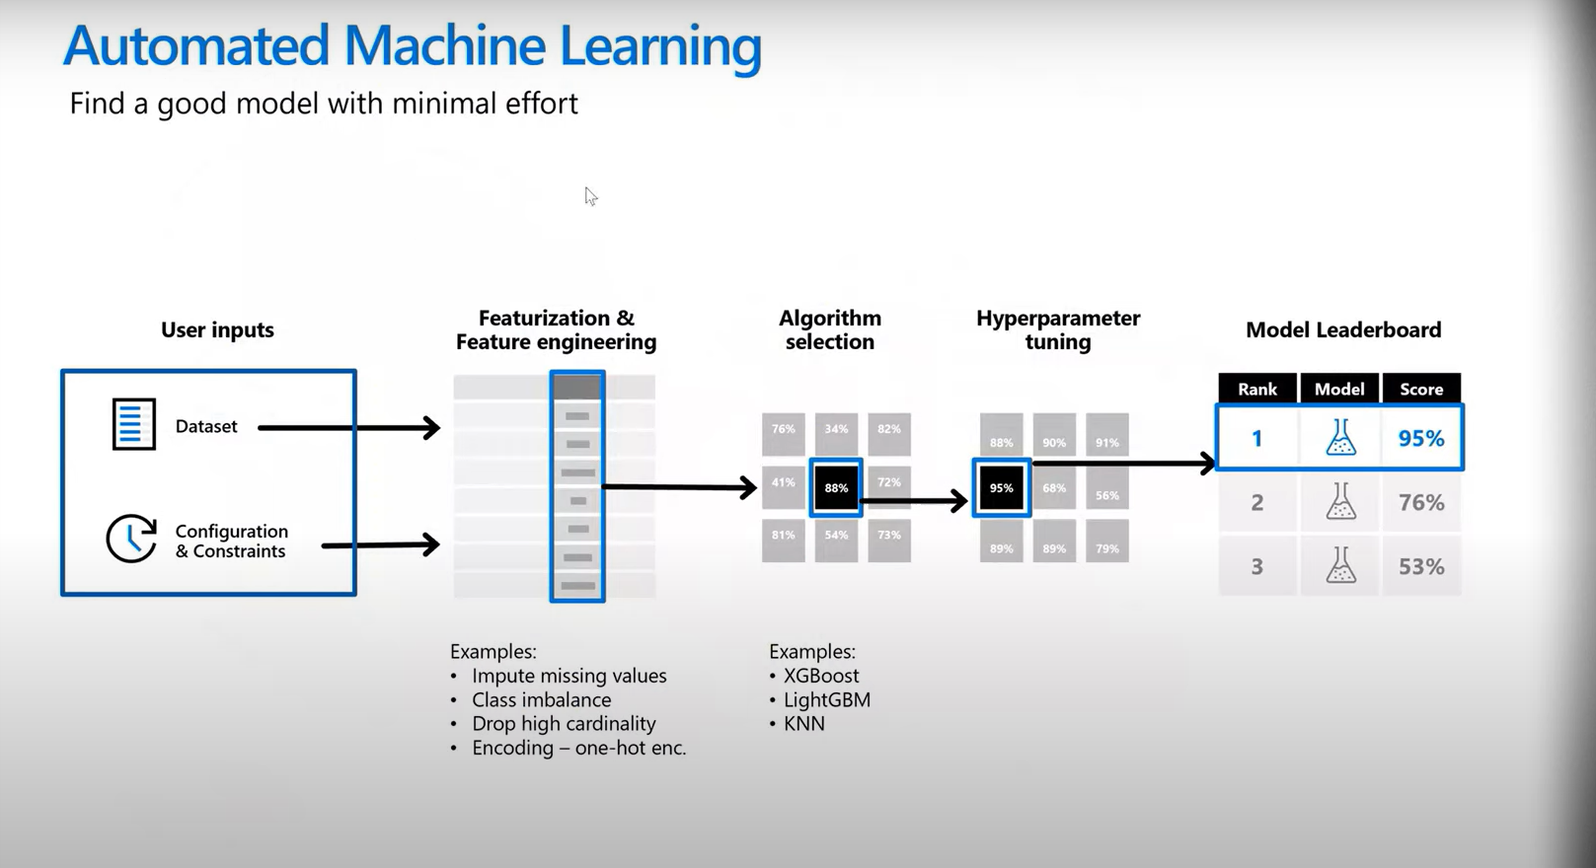

Slide 28
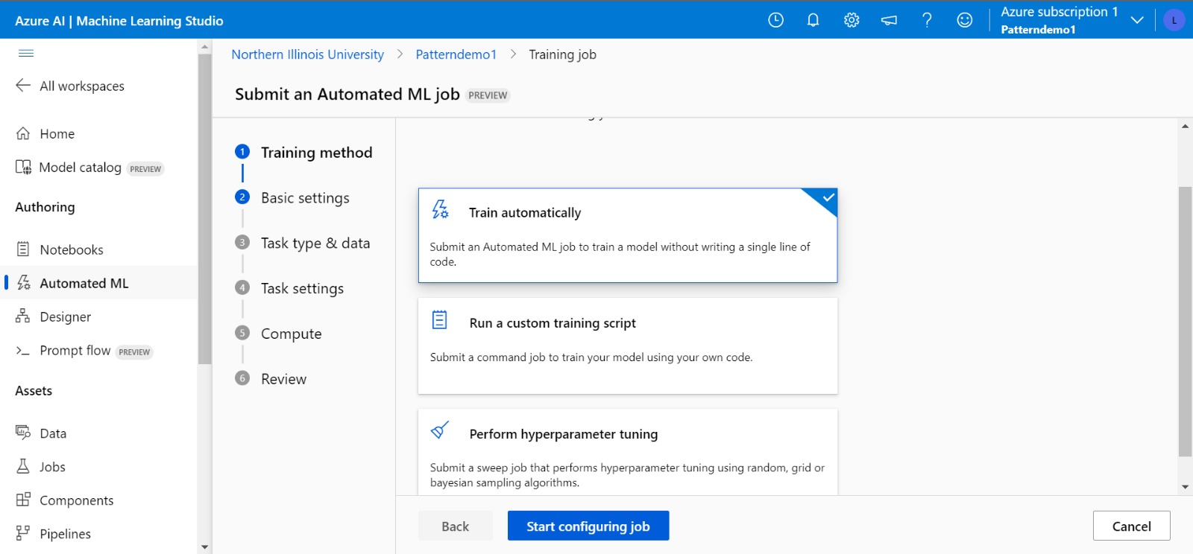

Slide 29
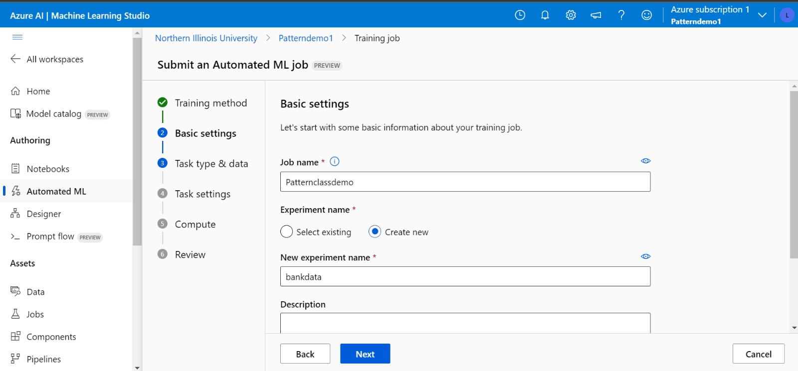

Slide 30
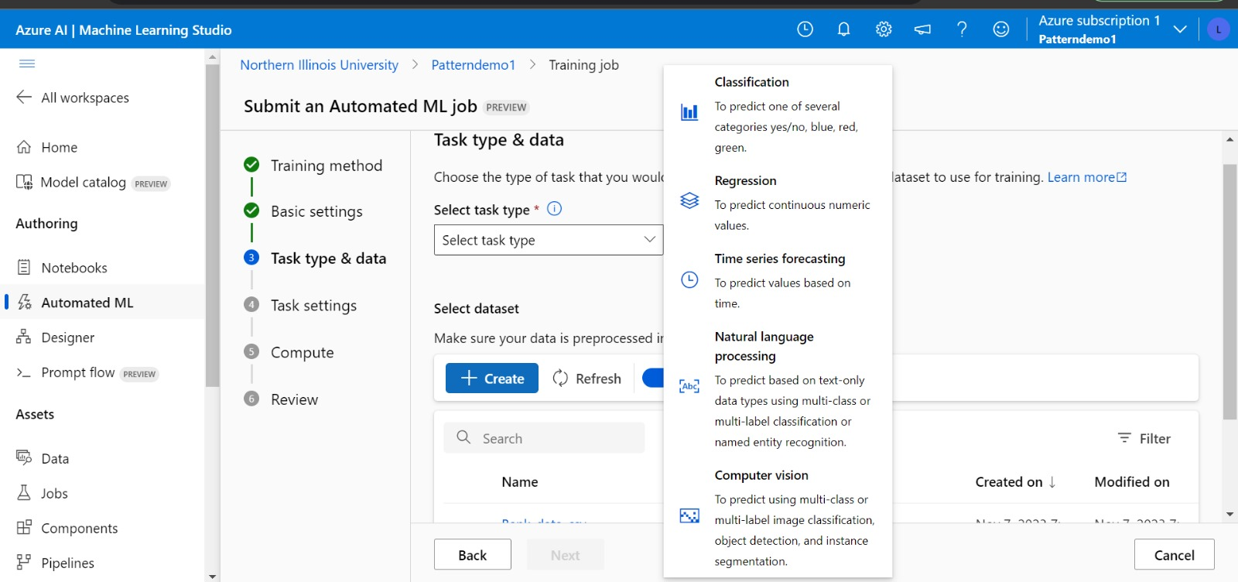

Slide 31
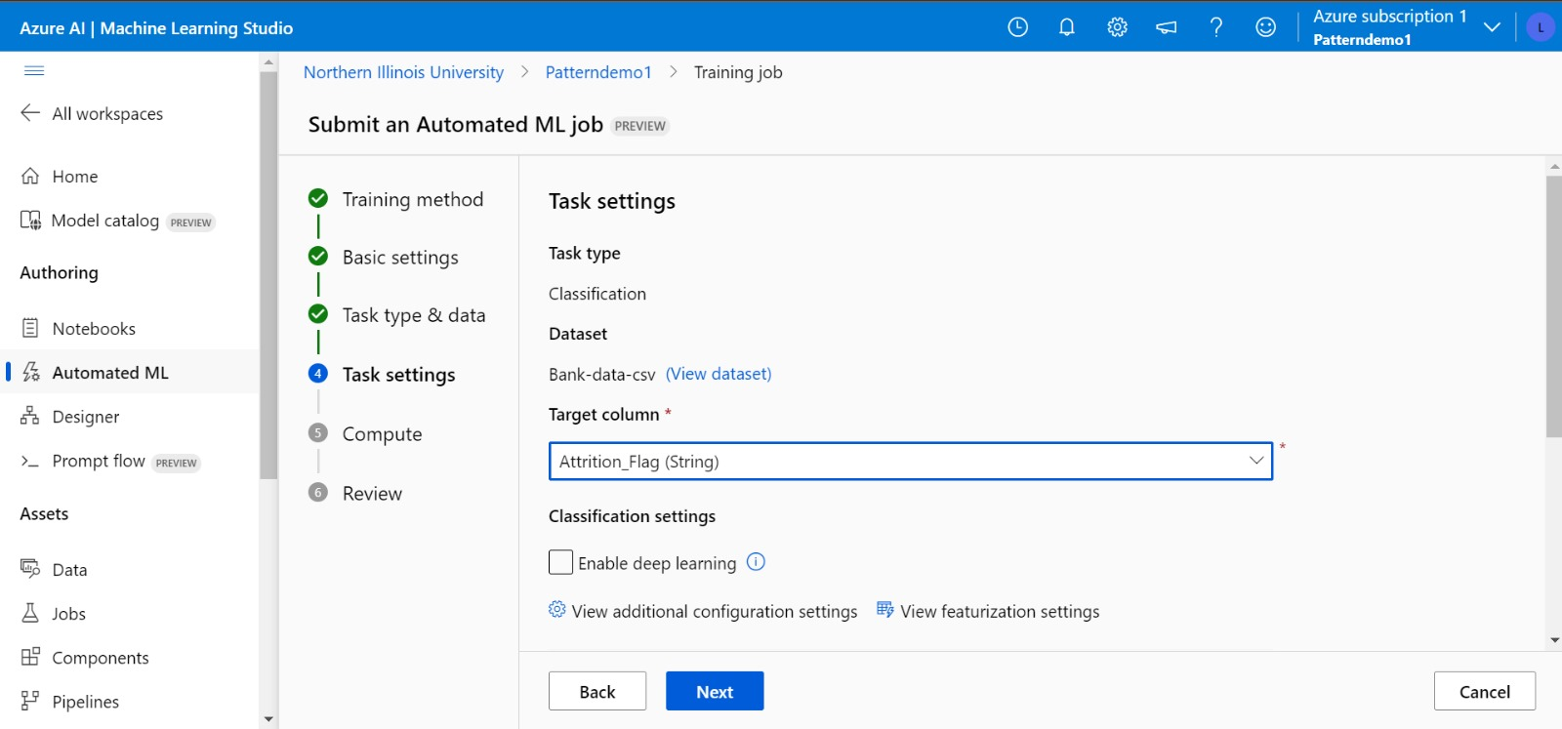

Slide 32
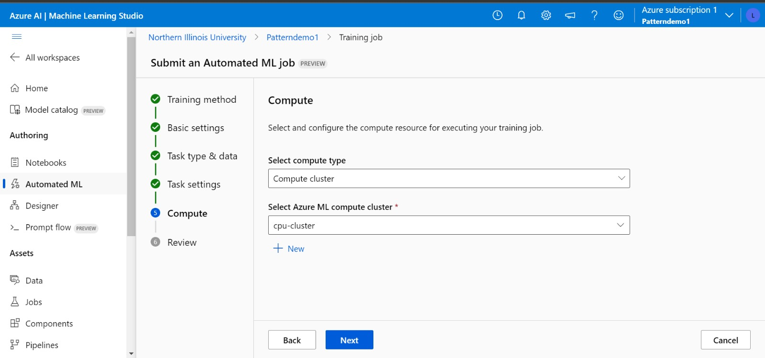

Slide 33
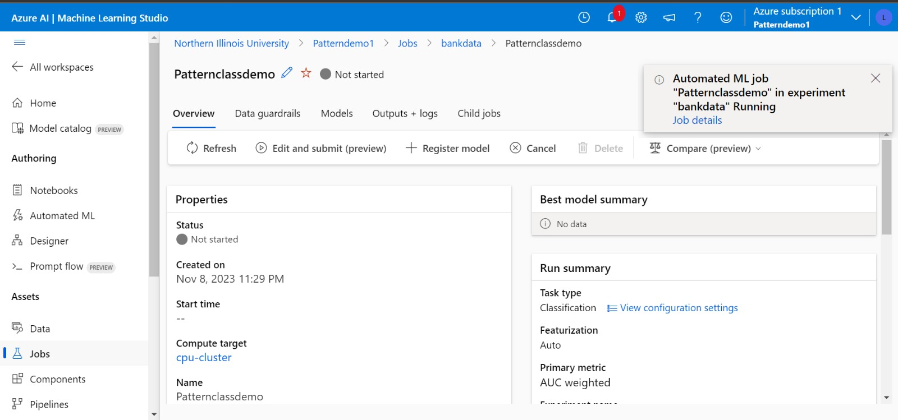

Slide 34
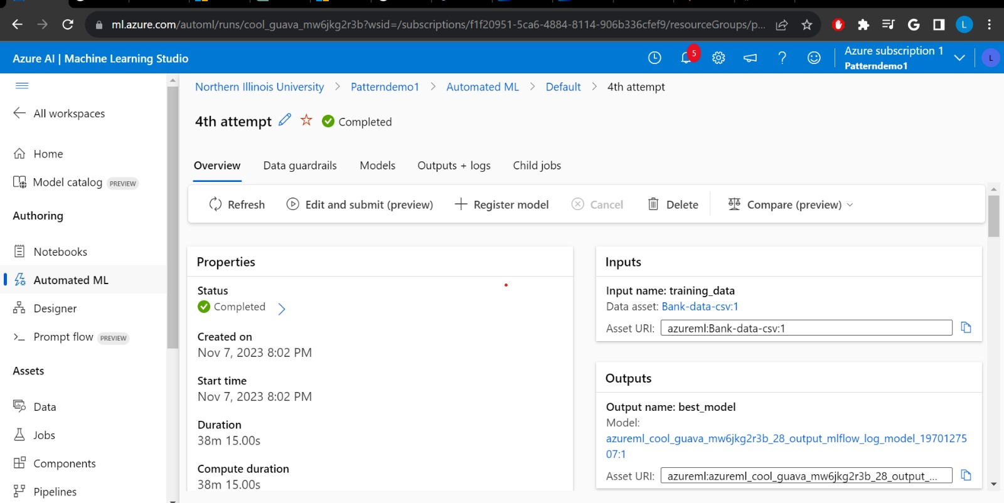

Slide 35
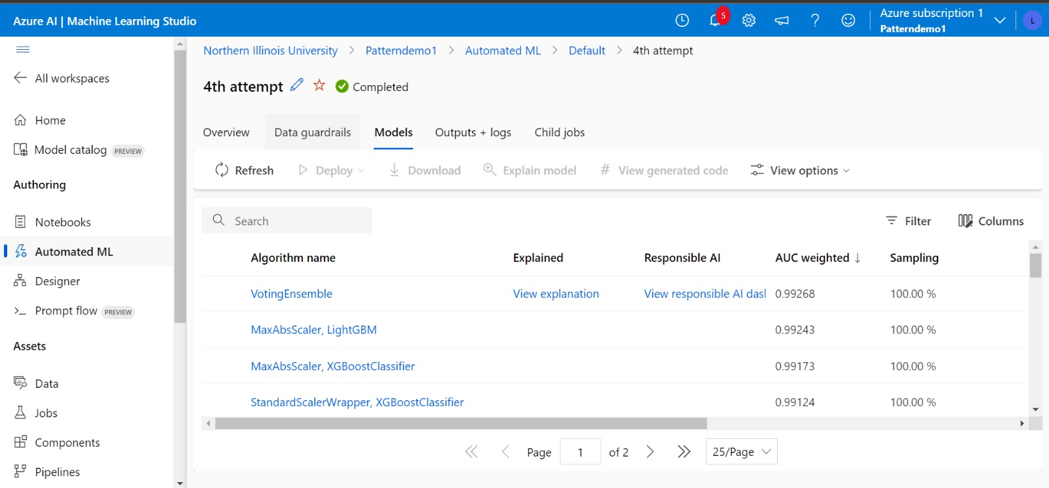

Slide 36
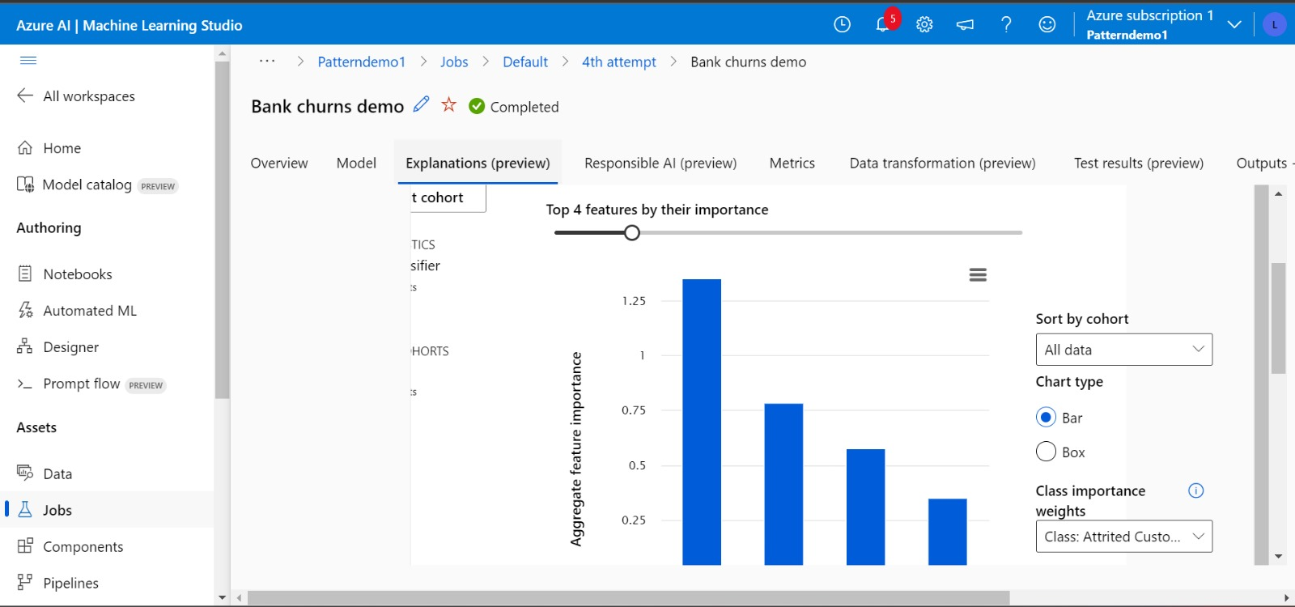

Slide 37
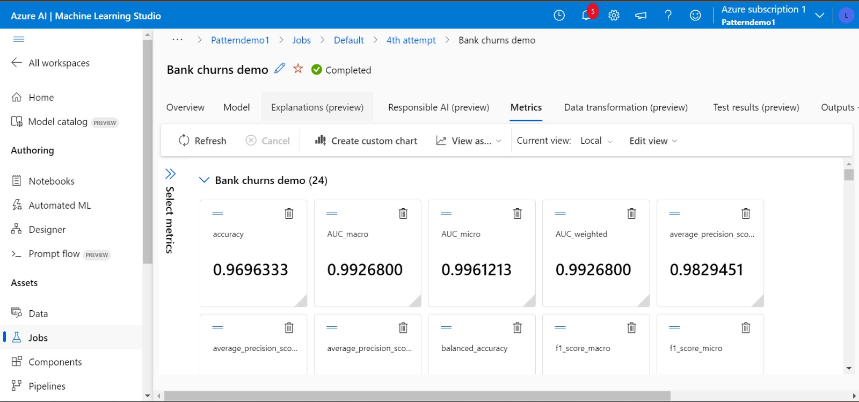

Slide 38
Comparison of three tools
Accuracy of Auto sklearn - 96.5%
Accuracy of Azure - 96.96%
Accuracy of H2O – 97.03%
Here only binary classification was explored with one dataset, and H2O performs best in this case
There are many autoML tools out there which specializes in specific areas like AutoTS specializes in time series dataset, AutoGluon specializes in multi-class problems and H2O AutoML “slightly outperforms the others for binary classification and regression.

Slide 39
Limitations of AutoML
Resource Intensive
Limited Algorithm Options
Dependency on data quality
Customization and domain knowledge – not suitable for models which require domain specific information
Limited model transparency - doesn't provide extensive tools for model interpretability
Scalability – can not deal with large datasets and complex feature engineering
Limited control – not for advanced users

Slide 40
Thank You
Questions?

